Slide 1
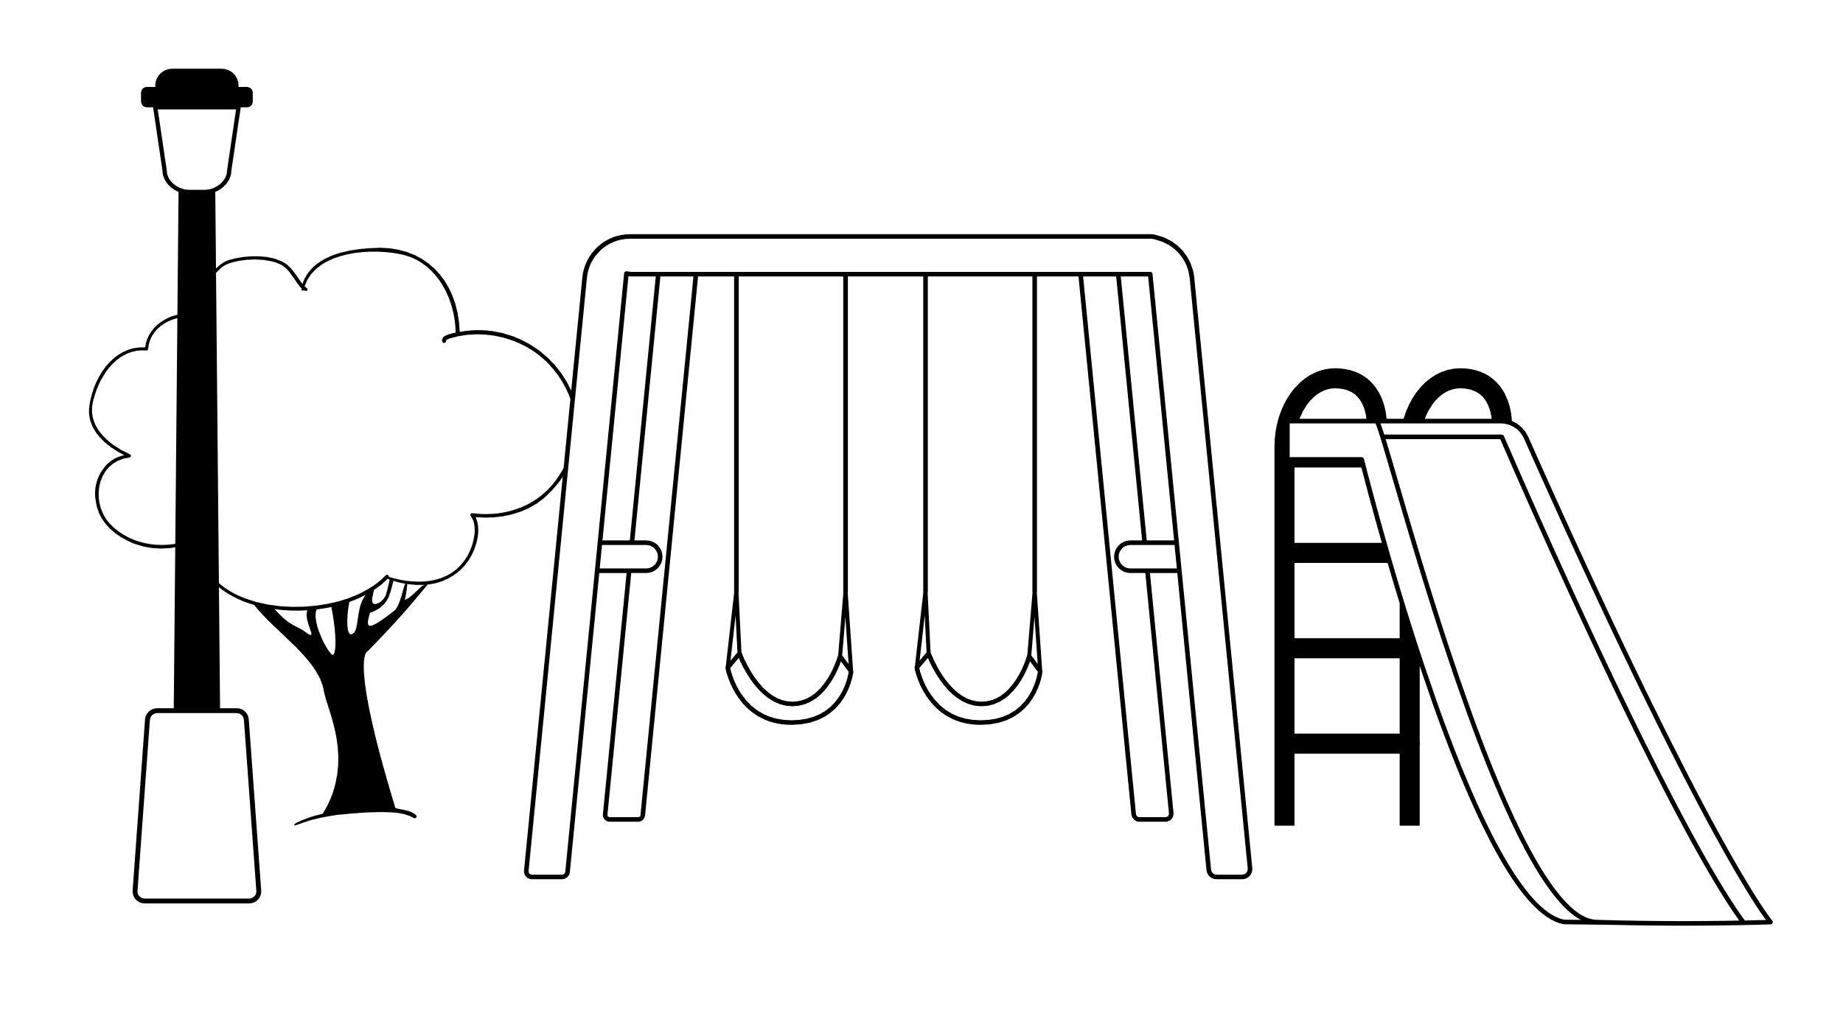
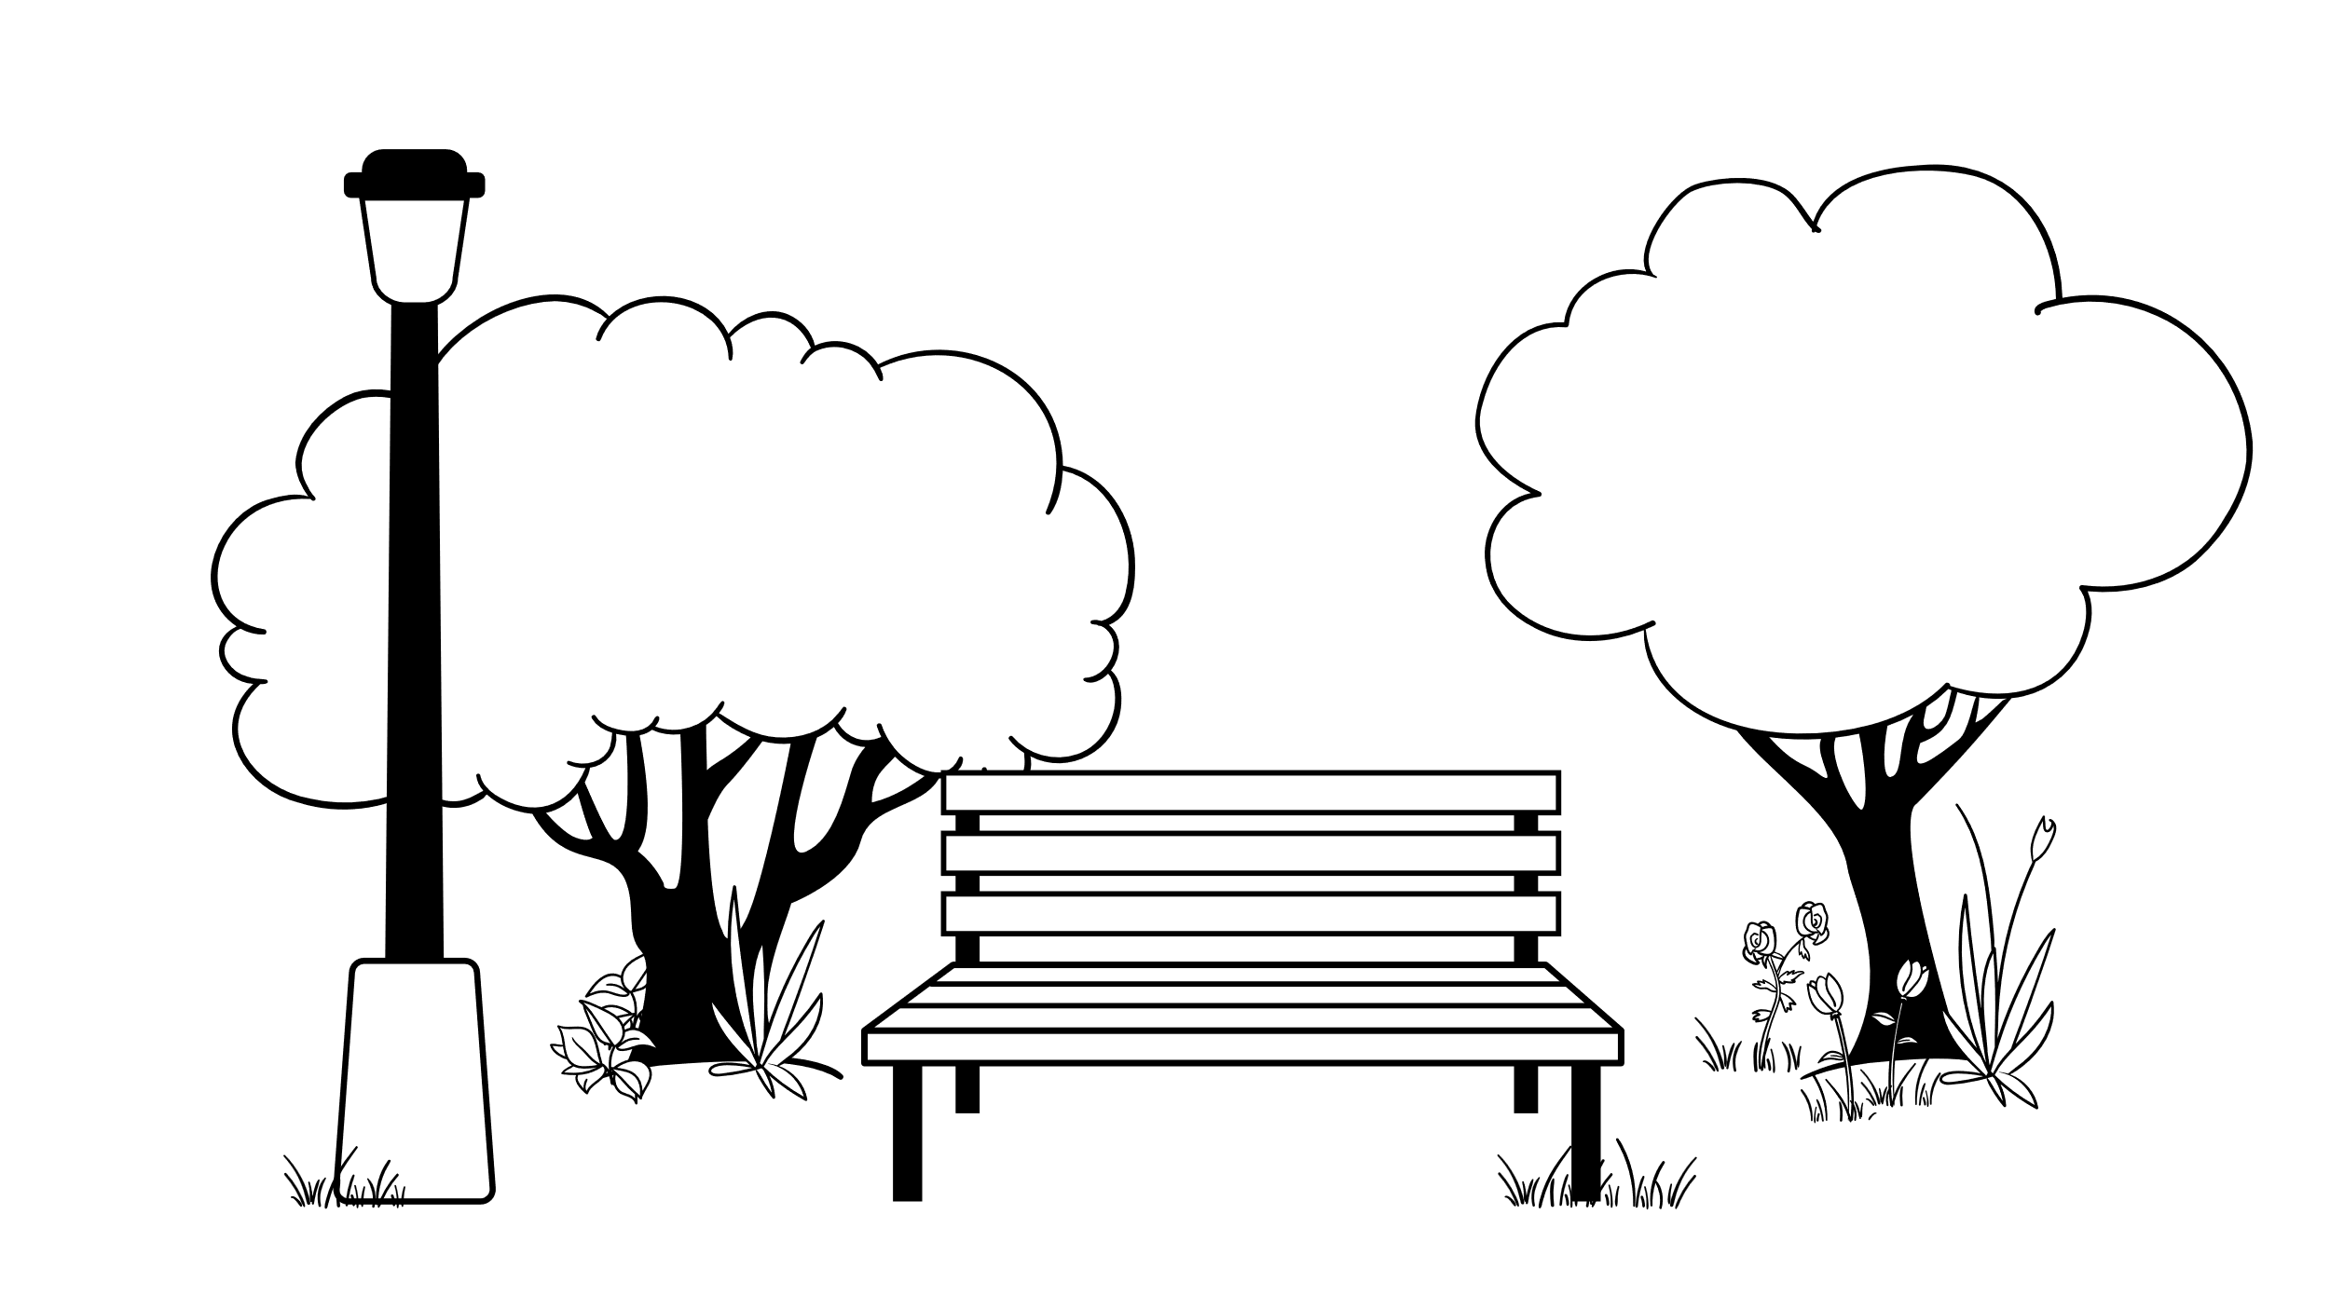
Candy Town Map
 | Sweet Street | Confectioner Blvd |  | Sugar Ave
 |  |  | 5-7 |  | 6-8
5 |  | 6
3 |  | 4 | 1-3 |  | 2-4
1 |  | 2

